Slide 1
Diego Andres Montealegre Garcia
Wednesday, 3 June 2020

Slide 2
Contenido
GIT
Que es?
Descargar GIT
Comandos Basicos
Repos Vs Directorios
Branch
Prueba de Concepto
Crear un repositorio
Agregar el archivo readme
Crear un branch / modificarlo
Subir los cambios al Master
Preguntas

Slide 3
GIT – Que es?
Software de Control de versiones
FIN
.

Slide 4
Comandos Basicos Git
Accedemos a la URL
https://github.com/di3goandres/ComandosGit

Slide 5
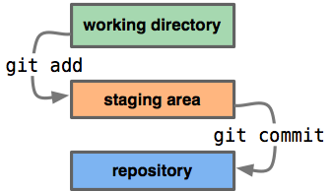
Repos vs Directories
Repositories are timelines of the entire project, including all
Directories, or ‘working directories’ are projects at their current state in time.
Any local directory interacting with a repository is technically a repository itself, however, it is better to call these directories ‘local repositories’, as they are instances of a remote repository.

Slide 6
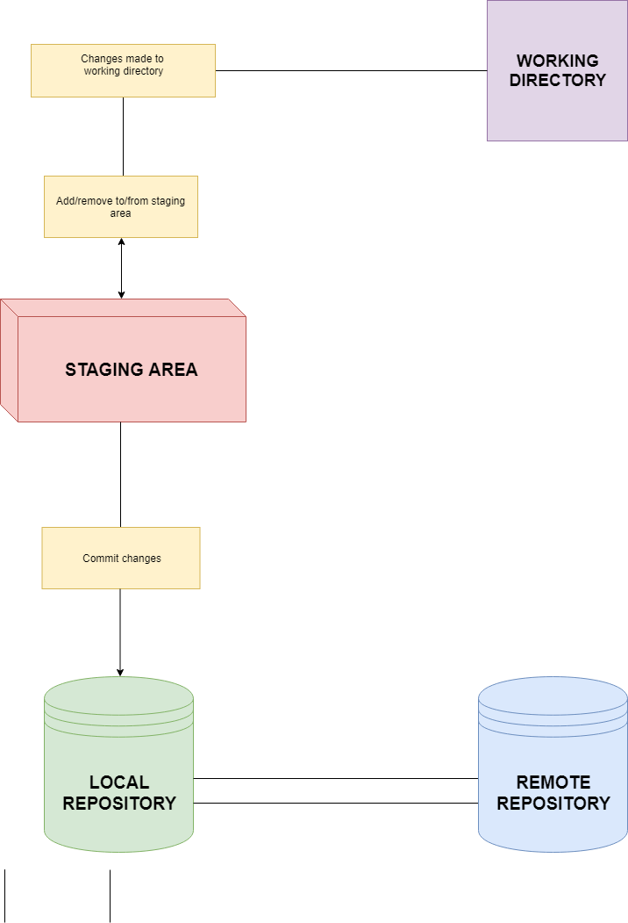
Workflow Diagram
This diagram shows a little bit about how the basic Git workflow process works
The staging area is the bundle of all the modifications to the project that are going to be committed.
A ‘commit’ is similar to taking a snapshot of the current state of the project, then storing it on a timeline.

Slide 7
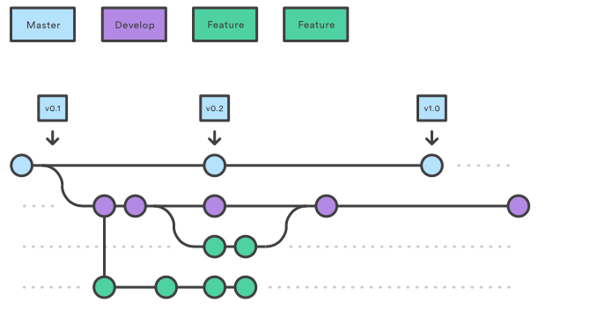
Branches
Git Branches are a way to create separate development paths without overriding or creating copies of your proyect
Branches can be added, deleted, and merged just like regular commits

